Slide 1
LearnX Sales forecasting

Slide 2
Problem Statement :
Predict the sales price for the house based on features of the house.

Slide 3
Overview (Layout of the Presentation)
Features
Individual Feature Behaviour
Feature Behaviour based on Prices
Features selected after analysis
Mean Model
Insights - New features

Slide 4
Features
Continuous
Categorical
Price
sqft_living
sqft_lot
sqft_living15
sqft_basement
sqft_above
yr_built
sqft_lot15
latitude
Longitude
yr_renovated
zipcode
Grade
Condition
View
Id
Bedrooms
Bathrooms
Floors
Waterfront

Slide 5
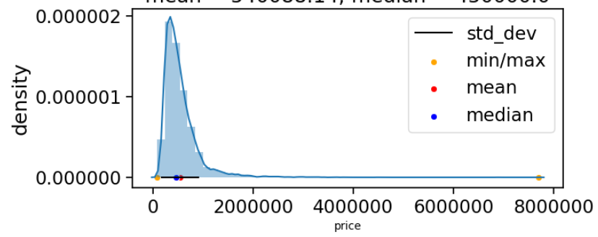
Summary of features (Univariate Analysis)
ID – 21436 out of 21613 unique ids for every house sold. (177 houses were sold multiple times.)
Date – The final date of the house sold in years 2014 2015 Majority sale for year 2015
Year_built – Houses built from year 1900 to 2015 Major houses were built near 1980 and around 2015
Price – Houses priced from ( 0 80000000) Majority of houses at price range *( 0 2000000)
Cont.

Slide 6
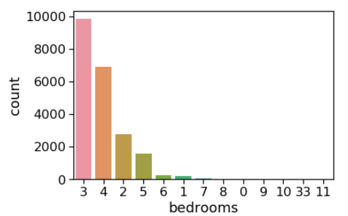
Bedrooms – Range (133) Maximum houses had rooms in range (2 6)
Bathrooms – Range (1 – 6.5) .5 means attached to bedroom with no shower Maximum houses rage were for (1 - 2.5)

Slide 7
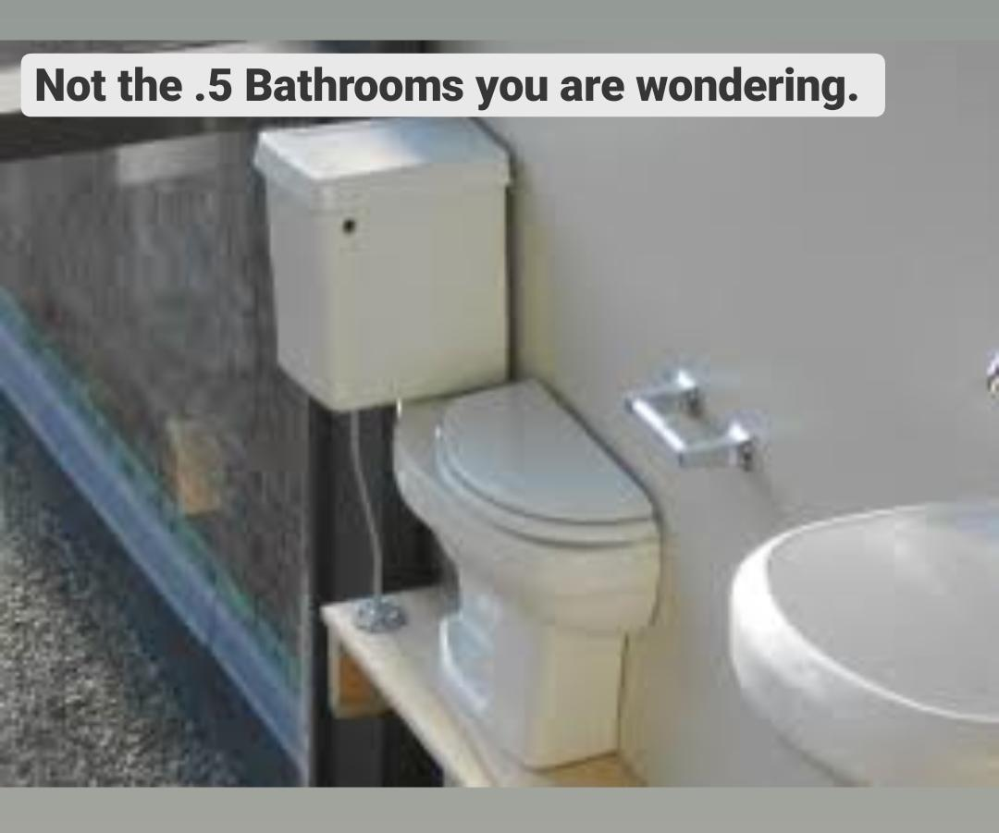
The .5 Bathrooms meant “Attached with a Bedroom” (and with no shower)

Slide 8
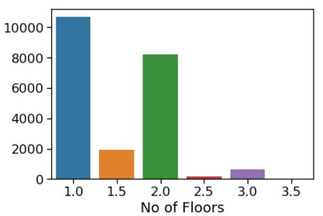
Grade – Houses are graded in range (113) – {2} Majorly graded houses range (610)
Condition – On the basis of Plumbing of house Range (15) 1 – Bad and 5 – Excellent Majority number of houses for 3 and 4
View –No of times Houses were viewed pre-Purchase Range (04) Majority preffered Range 0 and 2
Floors – Total Range (1 3.5) .5 means Penthouse Maximum Range for 1 2 1.5

Slide 9
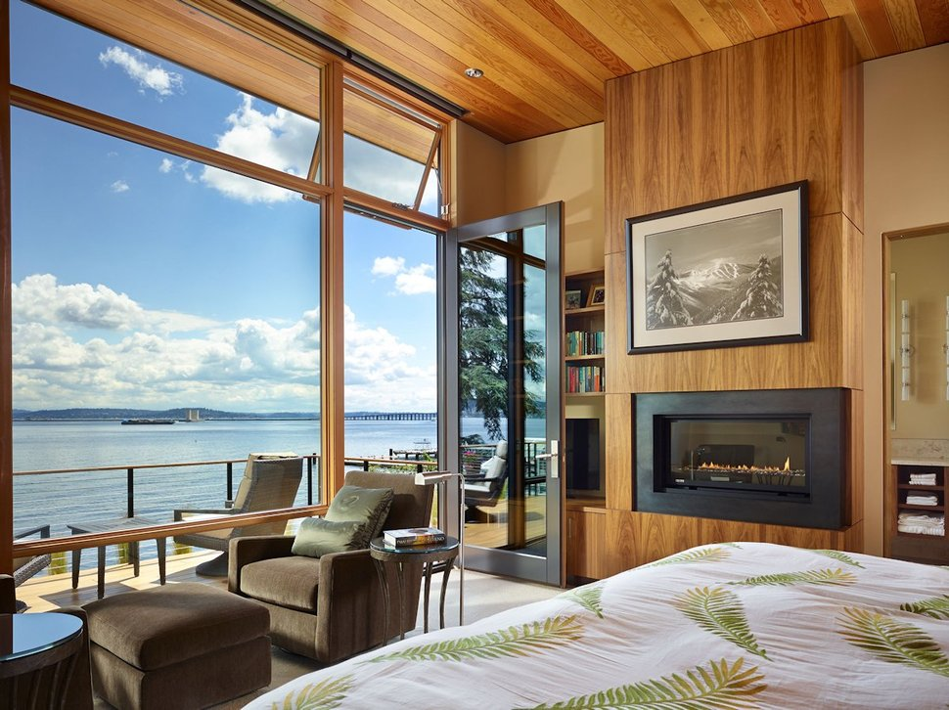
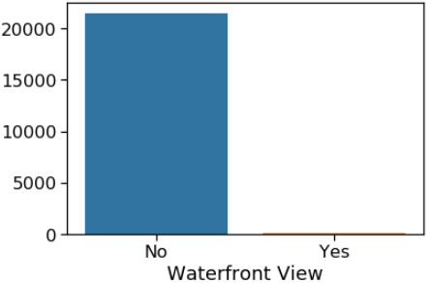
WaterFront – Either No or Yes. Majority had No waterfront.
Majority had No waterfront.

Slide 10
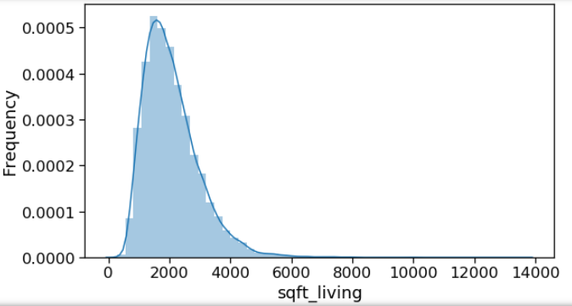
Sqft_living – Total Range (014000) sqft Majority Range (04000)
Sqft_lot – Total Range (0 1500000) sqft Majority (0 150000)
Sqft_above – Total Range (0 10000) sqft Majority (03800)
Sqft_basement – Total Range (05000) sqft Majority Range (2001000)
Sqft_living15 – Living Area To nearest 15 neighbours Total Range (0 6000) sqft Majority (5003500)

Slide 11
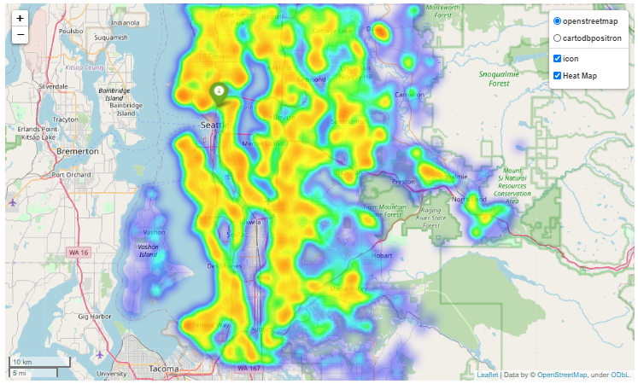
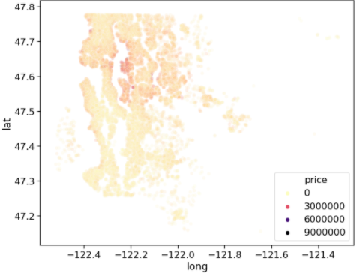
Zipcode – Total Range (98001 98199)
Latitude – Total Range (47.15 47.77)
Longitude – Total Range (-122.51 -121.31)

Slide 12
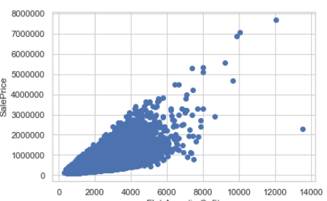
Summary of features w.r.t. Sale price (Bivariate Analysis)
Sqft_living – Changes Linearly positively with change in prices. (If sqft_living increase by 10 then we can be certain that price would Surely increase differing on the rate checked with Correlation value) Correlation value – 0.702
Sqft_above – Changes linearly Correlation – 0.6055
Sqft_living15 – Changes Linearly Correlation – 0.5853
Sqft_basement – Changes Linearly Correlation – 0.323

Slide 13
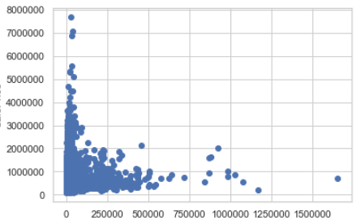
Sqft_lot – Does not have major effect of prices. (If sqft_lot increase/decrease by 10 units we are not certain about how price would change ) Correlation – 0.0089
Sqft_lot15 – Not much effect wrt money. Correlation – 0.082

Slide 14

Better condition houses have high price tags.
Grade of house can increase with HousePrice.
Increase in Number of Bathrooms can increase the price.
Increase in Number of Bathrooms can increase the price.
Houses with waterfront view seemingly had the highest sale prices.
Special Features -
Bathrooms rates were increasing irrespective of special features
Floors were also not behaving different due to special features.
P.S. -- (Rechecked results with T Z tests when necessary)

Slide 15

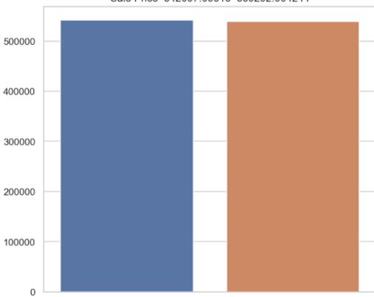
T test result for Date Column
Date – Not much difference in prices in just One year gap
2014
Not 2014

Slide 16
Features considered after analysis
Continuous Features
Sqft_living
Sqft_above
Sqft_living15
Sqft_basement
Categorical Feature
Floor
Condition
View
Bedrooms
Bathrooms
Grade

Slide 17
Feature engineering (Made some new features from existing to understand data better)
From our dataset we came up with below features(14 features) to help our model.
Age - Year_built minus Date (Year House was Sold) (labelled – Very old (130 yr) old common new very new(10 year) Maximum for – New and common
Month - Month of the house sold
week - Week of house sold
bathroom_bedroom - Sum of number of bedrooms and bedrooms
bedroom_bathroom_ratio - Ratio of bedroom and bathroom
bathrooms_num - Integer part of bathrooms
bathrooms_feature - Decimal part of bathroom represent special feature

Slide 18
Continued.. (More features)
Floor_num - Integer part of floor.
Is_penthouse - Fractional part of floor represent penthouse
n_grade - Combined data of grades which have less number of records in sample
sqft_living_lot_ratio - Ratio of sqft_living and sqft_lot
sqft_living_above_ratio - Ratio of sqft_living and sqft_above
sqft_lot_above_ratio - Ratio of sqft_lot and sqft_above
lat_long_ratio - Ratio of latitude and latitude
bathroom_bedroom - Sum of number of bedrooms and bedrooms
bedroom_bathroom_ratio - Ratio of bedroom and bathroom

Slide 19
Implementing our prediction model
We are using Linear regression and its regularization techniques to predict the house price.
To find the best model that we can use to find insights we are using r2 score and rmse value.
In simple terms:
*Higher the adjusted r2 score better is our model
r2_base
r2_improved
r2_better

Slide 20
Feature selection and its impact
To improve our linear regression model performance we tried:
Checked the assumptions of our model
Selecting features based on VIF and p-values
Implementing Backward/Forward feature selection
Type of model | Rmse | Adj R square
Linear regression without Feature engineering | 1.8e+05 | 0.737
Linear regression with Feature engineering | 1.8e+05 | 0.751
Linear regression after backward feature selection | 1.8e+05 | 0.746

Slide 21
Features after macro Selection
bedrooms
sqft_living
waterfront view
sqft_above
sqft_basement
yr_renovated
zipcode
lat
long
sqft_living15
bathroom_bedroom
sqft_living_lot_ratio
sqft_living_above_ratio
sqft_lot_above_ratio
lat_long_ratio
age
bathrooms_feature
bathrooms_num
grade

Slide 22
Micro-tuning techniques:
Ridge – Adds a penalty to reduce impact of insignificant features
Lasso – Acts as a feature selector by applying a penalty to our features and turning less significant to zero.
Outcome:
Type of model | Rmse values | Adj R square
Ridge | 1.8e+05 | 0.753
Lasso | 1.8e+05 | 0.749
Linear regression after backward feature selection | 181376.935 | 0.746

Slide 23
Insights
We were able to improve our model performance using shared techniques.
Through our analysis we tried to formulate a better way to reduce overall time and improve our prediction score:
Significant features that dataset should include to help our model
Waterfront
Grade
Latitude
Age
Insignificant features:
Longitude
bathroom features
zipcode
sqft_above
bedroom-bathroom ratio
Sqft_living – sqft_lot ratio
Condition
View

Slide 24
Thank you

Slide 25
Appendix:

Slide 26
Initial Hypothesis
House Prices are dependant on two factors :
House price = Area(Carpet area + built up area+ other factors) * Rate (Feature + Facilities available + other -factors)
Area Affecting Factors --
Build-up area (More) would increase prices
Carpet area (more) increases house prices.
More rooms results in high house price.
Basement Area (Changes in) may not have much difference on prices.
Rate Affecting factors –
New houses with respect to Age and Less Renovation gap might have more prices
Sea-facing houses leads in more prices
Houses in excellent conditions would more price than houses.
Better Graded House are expensive.

Slide 27
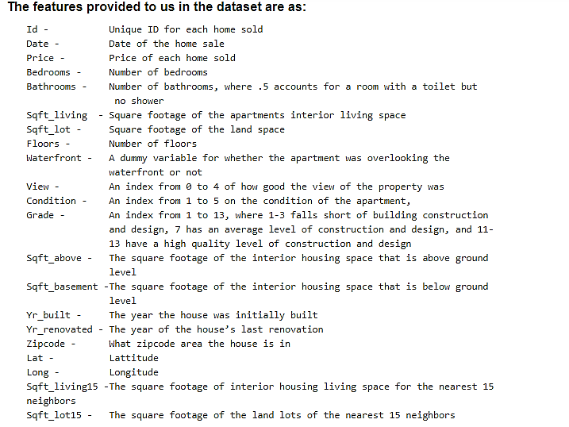
KC Housing Price dataset

Slide 28
Data validation:
We performed few checks on the dataset to find and fix any anomalies in the loaded dataset.
No. of Null values in the dataset – Zero
Column datatype – some datatypes are not correctly identified and we need to change their datatype.
Changed date feature to Datetime.
Created two separate columns holding year and month of the house sold date.
Changed few features as - “grade” ”condition” ”waterfront” ”view” to category datatype.
Created a separate column holding “age” of the house from feature “yr_built”.

Slide 29
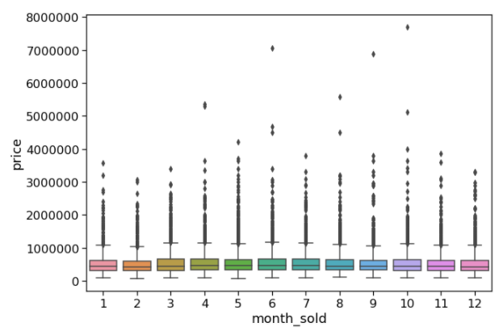
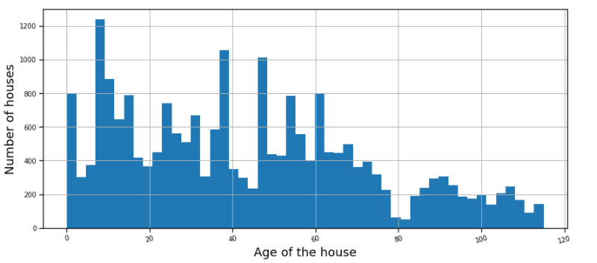
Few plots for Continuous Variables Features
Date(month wise) data distribution
Histogram showing number of houses in terms of their age
1-jan 12-dec

Slide 30
Inference from Univariate Analysis
From our analysis on each continuous feature main points that came out were:
Id variable(unique identifier) had few repeated values and found out that some houses were sold multiple times.
Date variable when plotted showed uneven distribution so no house buying pattern.
For Living Area (sqft_living) we had right skewed plot under the area of 1000 and 4000 sqft.
Had some outliers around 10000 sqft.
Similar were the inferences for other area features.
For latitude and longitude we saw a pattern in latitude but for longitude.
Would look more into it further.
For age of the house we had the maximum houses built in last 40 years.
Minimum and maximum ages were 0(same year) and 115 years(a vintage classic).

Slide 31
Bivariate Analysis
Using the inference from Univariate analysis we started working on the relational analysis between features and with the target variable.
Lets divide our analysis from here into two parts:
Continuous –Continuous(Cont.-Cont.)
Categorical- Continuous(Cont.-Cat.)
While checking the correlations we worked on to test our hypothesis and asked several questions to the data that we initially drafted.

Slide 32
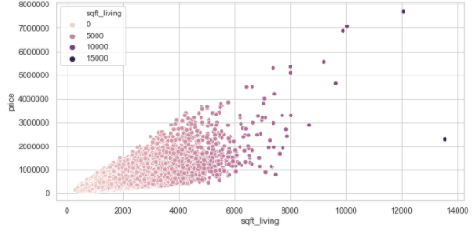
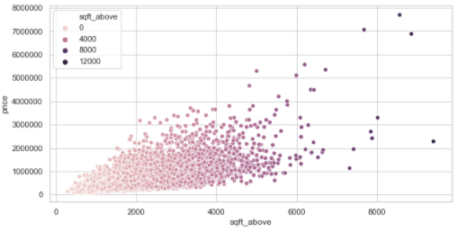
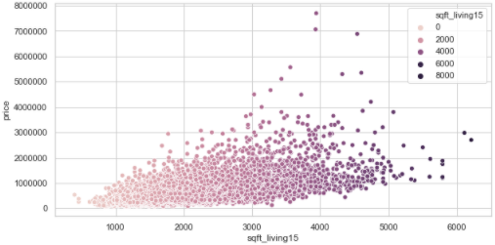
Area features to price
Sqft_living to price
Sqft_above to price
Sqft_living15 to price

Slide 34
Hypothesis and their outcome:
Were Prices always Increasing with the increase in area features.
-- Majorly Not all of them. But yes They either had increasing linear relation or null effects on target variable
Were few points seen on Scatter plots of sqft_living and sqft_above outliers or a part of the trend?
-- On diving further and trying to find connection they were Outliers and would be best to remove.
Price vary with the month (Do we have a pattern following the dates?)
No impact because of the period at which the house was bought (year or month).

